Slide 1
LI: To explain answers and justify with evidence from the text

Slide 2
What is P.E.E?
As well as having lots of ideas, you need to explain them clearly. One really effective way of doing this is to use P.E.E.
P.E.E shows that you have read and understood a text.
P.E.E stands for:
Point – Make a point.
Evidence – Find evidence from the text to back up your point.
Explanation – Explain how the evidence proves your point.
So if you're answering a question, state your point, back it up with a piece of evidence and then explain it.
Try out the P.E.E method. Here's an extract from The Wizard of Oz by Frank Baum.

Slide 3
A P.E.E Question
The Wonderful Wizard of Oz by L. Frank Baum
She was awakened by a shock, so sudden and severe that if Dorothy had not been lying on the soft bed she might have been hurt. As it was, the jar made her catch her breath and wonder what had happened; and Toto put his cold little nose into her face and whined dismally. Dorothy sat up and noticed that the house was not moving; nor was it dark, for the bright sunshine came in at the window, flooding the little room. She sprang from her bed and with Toto at her heels ran and opened the door. The little girl gave a cry of amazement and looked about her, her eyes growing bigger and bigger at the wonderful sights she saw.
How did Dorothy feel when she opened the door?

Slide 4

Make Your Point…
Question: How did Dorothy feel when she opened the door?
We need to scan the text to decide how Dorothy was feeling when she opened the door and looked outside.
She was awakened by a shock, so sudden and severe that if Dorothy had not been lying on the soft bed she might Have been hurt. As it was, the jar made her catch her breath and wonder what had happened; and Toto put his cold little nose into her face and whined dismally. Dorothy sat up and noticed that
the house was not moving; nor was it dark, for the bright
sunshine came in at the window, flooding the little room.
She sprang from her bed and with Toto at her heel, ran
and opened the door. The little girl gave a cry of
amazement and looked about her, her eyes growing
bigger and bigger at the wonderful sights she saw.
Point: It seems that Dorothy is amazed as she opens the door and is eager to explore.

Slide 5

Locate Your Evidence…
Provide a quotation from the text which supports your answer.
Evidence – We know this because the text tells us that: “The little girl gave a cry of amazement and looked about her, her eyes growing bigger and bigger at the wonderful sights she saw.”
When quoting from a text, remember to:
Use quotation marks.
Quote accurately.
Short, well-chosen quotations are better than long, vague ones.

Slide 6
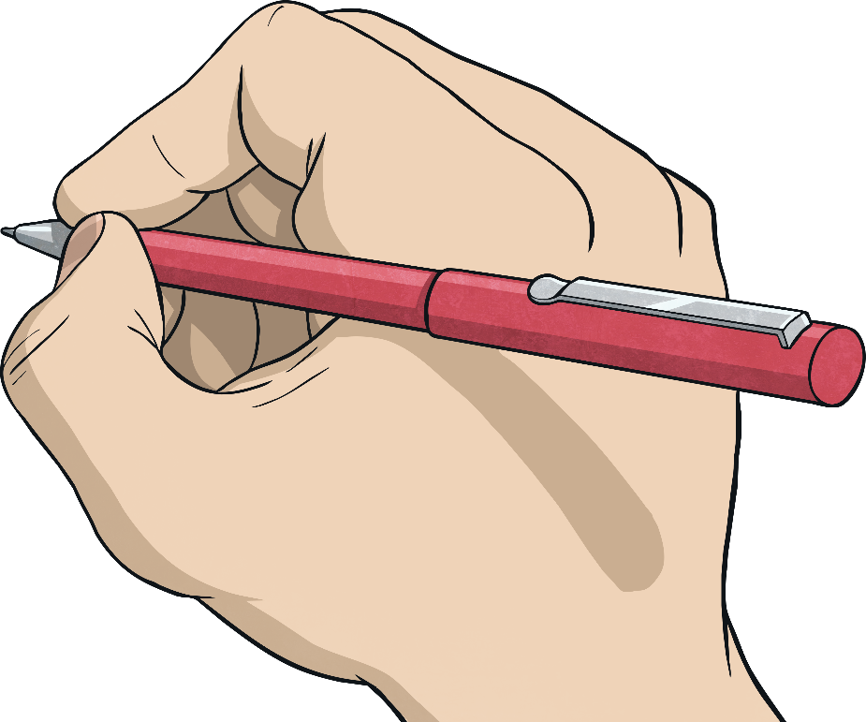
Explain…
You now need to explain how the text supports your initial point.
Explanation - Dorothy cried in amazement which indicates that she thought the sights she saw were wonderful. Also, the phrase 'her eyes growing bigger and bigger' gives the impression that she was astounded by what she saw and couldn't believe her eyes.
Remember that certain words and phrases are helpful when you're explaining an idea in some detail. The following list shows some of those phrases:
this implies
this suggests
which gives the impression that
possibly
perhaps
this indicates that
this shows
obviously

Slide 7
Put It All Together
Point – It seems that Dorothy is amazed as she opens the door and is eager to explore.
Evidence – We know this because the text tells us that: “The little girl gave a cry of amazement and looked about her, her eyes growing bigger and bigger at the wonderful sights she saw.”
Explanation – Dorothy cried in amazement which tells us she thought the sights she saw were wonderful. Also, the phrase ‘her eyes growing bigger and bigger’ gives the impression we know that she was astounded by what she saw and couldn't believe her eyes.

Slide 8
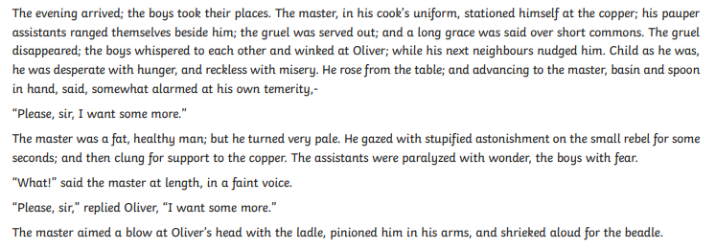
Look at this extract of Oliver Twist
Answer this question in your book using the P.E.E chain:
How do you think the Master felt when Oliver asked for more?

Slide 9
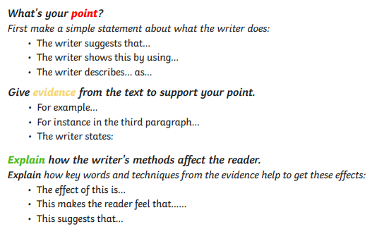
Your turn
Answer this question in your book using the P.E.E chain:
How do you think the Master felt when Oliver asked for more?

