Slide 1
Year 6 Grammar Revision
LI- To reinforce my understanding of pronouns

Slide 2
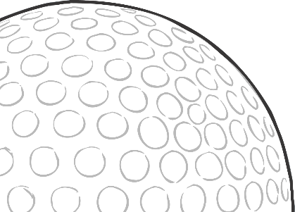

Pronouns: The Rules
Pronouns are words used to replace a noun. Without pronouns, spoken and written English would be very repetitive.
Nicola loves to play golf. She finds it very relaxing.
Sam heard a noise from the cave.
There was definitely something inside it.
There are six different types of pronouns…

Slide 3
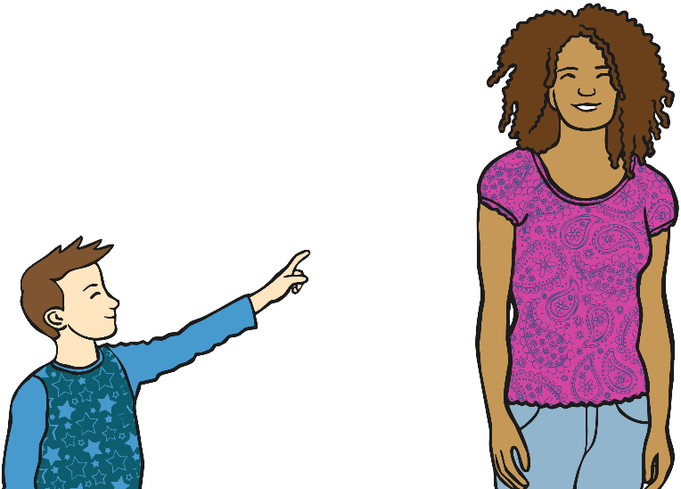
Personal Pronouns: The Rules
Personal pronouns represent people, places and things. They refer back to either the object or subject of the sentence. Personal pronouns often signal whether the noun they refer back to is singular or plural and its gender.
He pointed at her. She giggled at him.
them
it
we
he
him
you
she
me
you
I
they
us

Slide 4
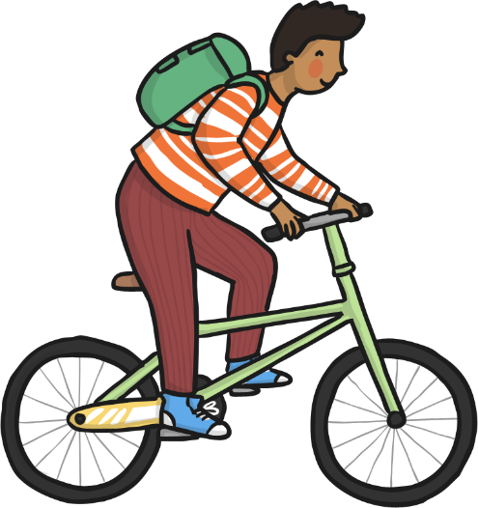
Possessive Pronouns: The Rules
Possessive pronouns show you the ownership of something. There are not to be confused with possessive apostrophe words. They don’t need an apostrophe.
The bike was his.
mine
hers
yours
its
theirs
his
ours

Slide 5
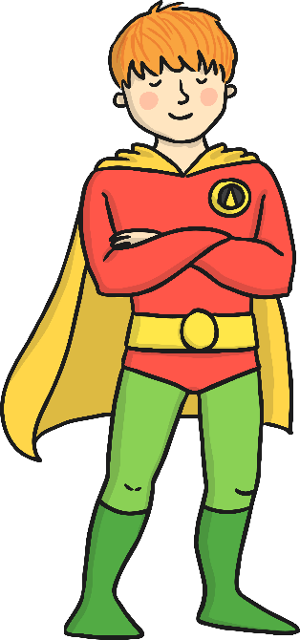
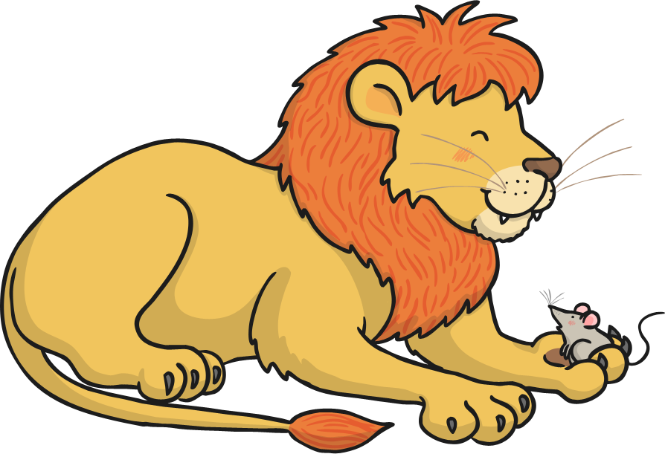
Relative Pronouns: The Rules
Relative pronouns are the first words used in a relative clause.
that
who
whom
which
whose
Jim, who was dressed as a superhero, was going to a fancy dress party.
The lion held the mouse, which made him nervous.

Slide 6
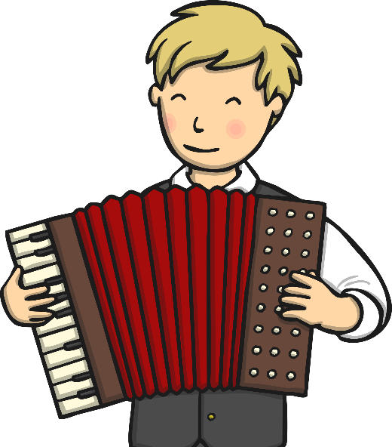
Reflexive Pronouns: The Rules
Reflexive pronouns reflect back on an earlier noun or pronoun.
myself
themselves
herself
yourself
himself
ourselves
He taught himself to play the accordion.
‘Himself’ refers back to the pronoun ‘he’.

Slide 7

Interrogative Pronouns: The Rules
Interrogative pronouns are used to ask questions when there is an unknown subject or object.
what
who
which
whose
whom
Who was that?
Whose are those?

Slide 8
Indefinite Pronouns: The Rules
Indefinite pronouns do not refer to any specific person or thing, but still can take the place of a noun.
somebody
someone
nobody
all
something
anybody
nothing
another
anyone
anything
no one
whose
each
many
most
other
some
few
none
such
There isn’t anyone at home.

Slide 9

Pronouns: The Tricky Bits
The two most commonly misused personal pronouns are:
me
I
Me and Danielle worked at the computer.
This sentence is incorrect. Think about it… would ‘me worked at the computer’ be grammatically correct?
Danielle and I worked at the computer.
‘I’ is the correct pronoun to use. Always place the other person first.

Slide 10
Pronouns – Quiz Question 1
Underline six pronouns in the following passage.
Bob and Bert went shopping for a camping equipment. They bought a tent for themselves. It came with free sleeping bags. Bob gave his
to someone else because he already had one.
Notes:
10

Slide 11
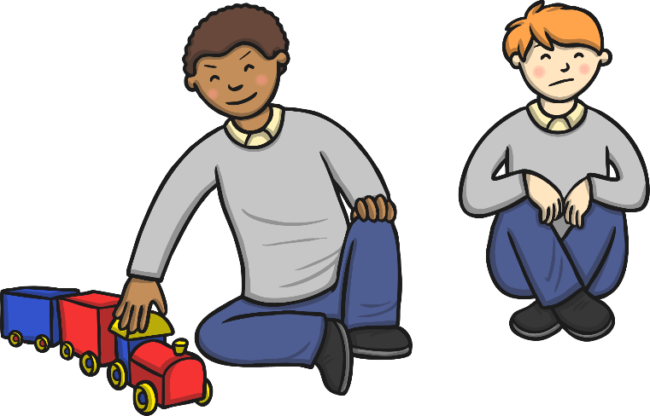
Pronouns – Quiz Question 2
Add a possessive pronoun to this sentence:
“You can’t play with the train – it’s _____________”.
mine
Notes:
11

Slide 12
Pronouns – Quiz Question 3
Rewrite the sentences, replacing the underlined nouns with the correct pronouns.
Sara played Scrabble even though Sara doesn’t really like Scrabble.
Sara played Scrabble even though she doesn’t really like it.
Some Australian spiders are venomous so be careful not to
approach the spiders.
Some Australian spiders are venomous so be careful not to
approach them.

