Slide 1

St Mary’s Church of England
Primary School
Meet the teacher
Learn. Grow. Achieve. Flourish.
‘I instruct you in the way of wisdom and lead you along straight paths.’ Proverbs 4:11
Love. Respect. Peace. Wisdom. Responsibility. Honesty. Forgiveness. Resilience. Perseverance.
Ms Rockett
Year Lead
Rowan class
Maths lead
Mrs Parbhoo
Willow class
Writing lead
Mr Fuller/Ms Robinson
Maple class
Assistant Headteachers
Mrs Fogarty (Support and Interventions)

Slide 2


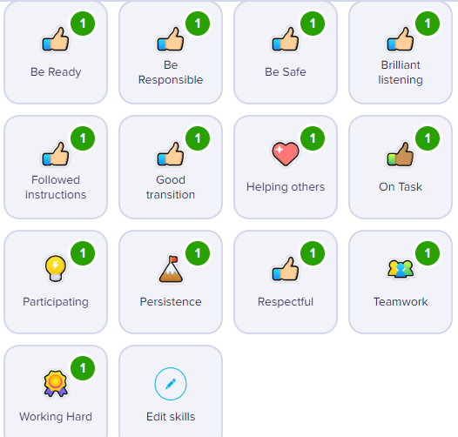
Behaviour Policy
Parent alerts. Keep up to date with your child’s achievements and celebrate their success.
Notes:
Ria?

Slide 3
The School Day
Every minute of learning counts so punctuality is vital
Teaching starts promptly at 8:20am.
Absences and persistent lateness are monitored.
Your child will be taught by more than one teacher over the course of the week.
Pupils will be set for writing and maths. These may change during the year.
Notes:
Musa ?

Slide 4




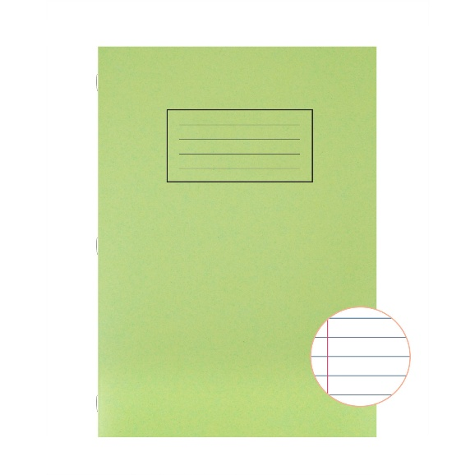
The School Day
Expectations - please check that your child has:
Reading record and reading book
3. Personal notebook
2. Homework book
Give
Please remove the following:
Toys
Cards
Additional stationary (we provide this in class)
Sweets/chewing gum
Notes:
Musa ?

Slide 5
The School Day
A change for this year:
Your child WILL NOT need to bring their PE kit
into school each week.
Instead, your child will come to school wearing
their PE kit and will wear it all day.
Children MUST take part in PE. It is a statutory subject – not optional.
Parents will be called to bring PE kits into school if pupils are not wearing them on the appropriate days.
Notes:
Musa ?

Slide 6
Your child will need to wear their kit on the following days:
Monday (writing sets) – this may change
Thursday

Slide 7



Homework
Mathletics & TTRS
St Mary’s will:
Pay for your child’s subscription.
teach your child up on how to log in and navigate the website.
Run practice demonstrations.
CELEBRATE effort and achievement
5 quizzes per week
10 minutes each day
Please inform me immediately by email if:
Your child is not doing their homework.
You have an issue with using a device.
Log ins are not working.
You are unsure of what homework your child must do.
30 minutes per week

Slide 8
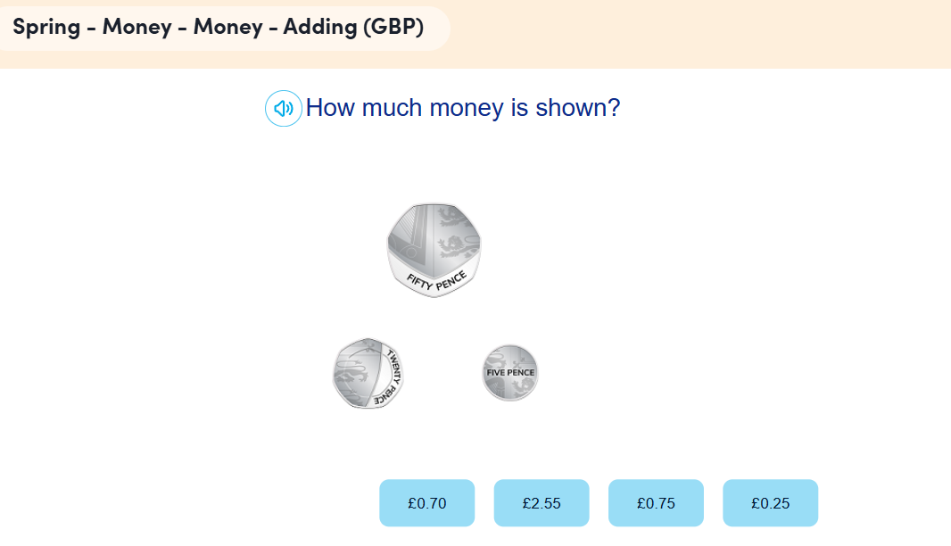
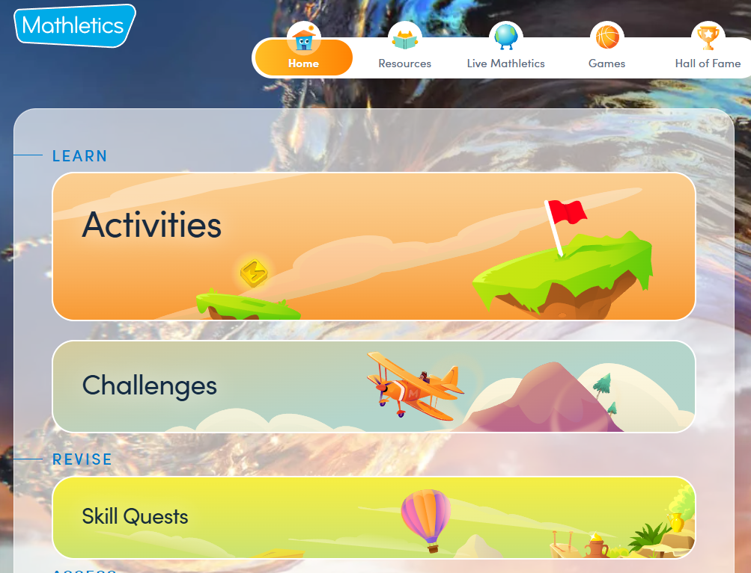
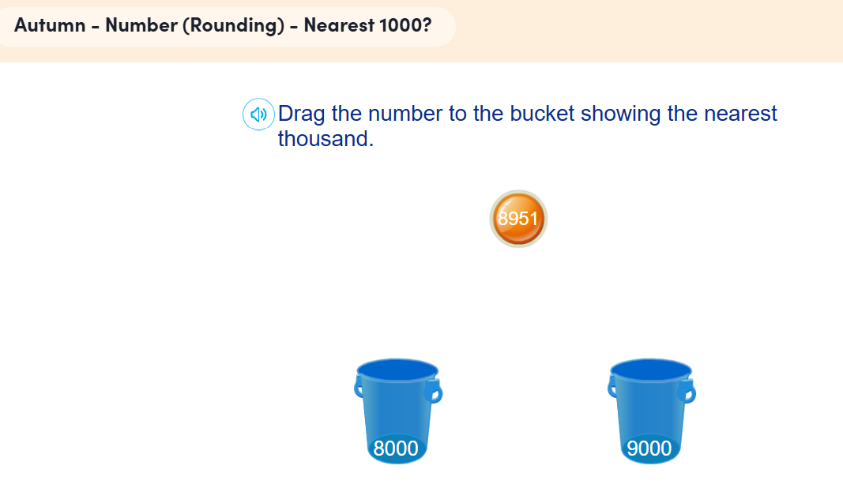
Homework
Mathletics & TTRS
5 quizzes per week
10 questions
Marked
Revision

Slide 9
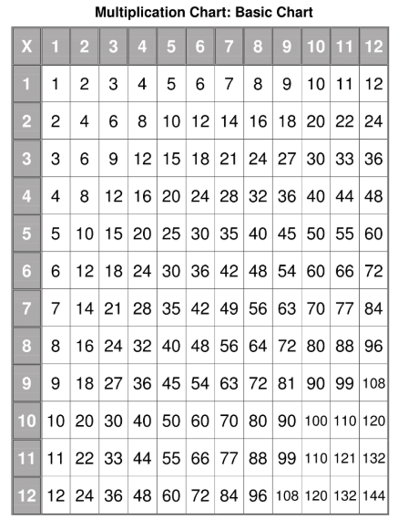
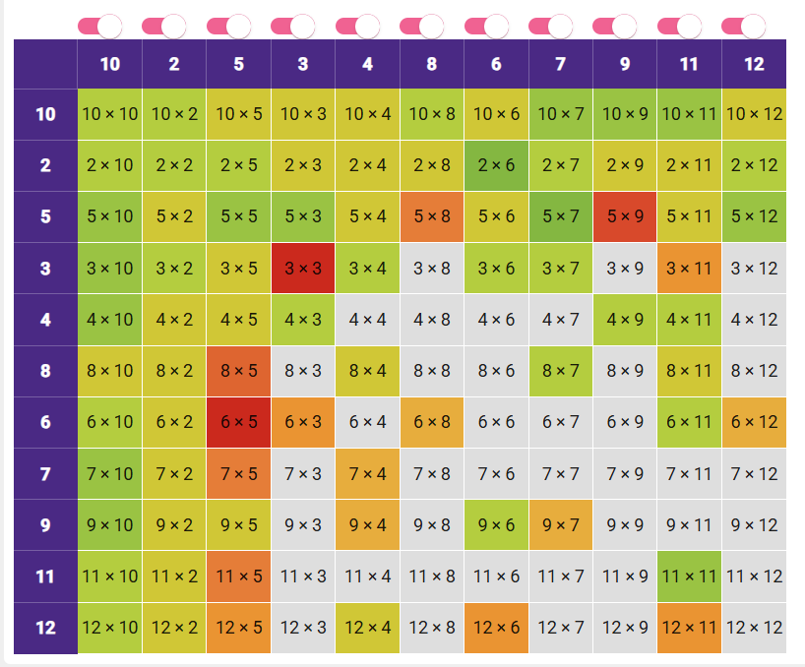
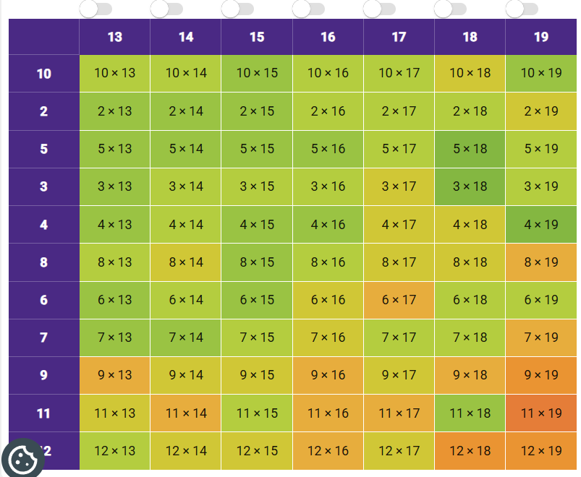
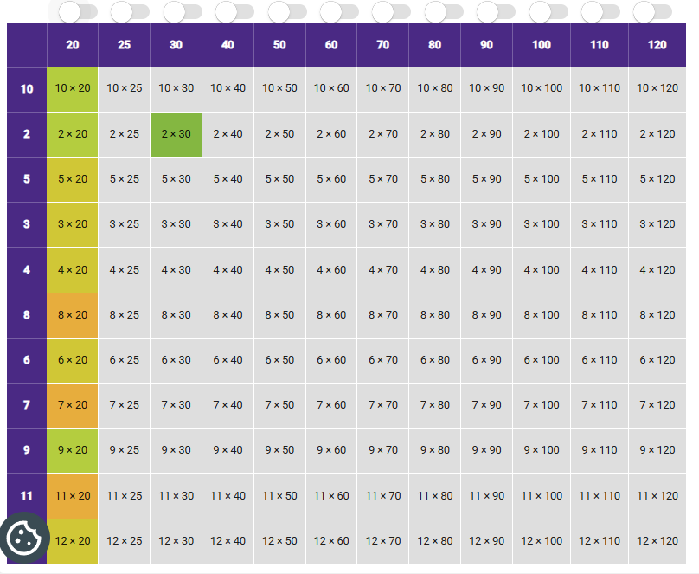
Homework
10 minutes each day
Revise and consolidate
up to 12 x 12
Use and apply with the
20, 25, 30 x etc
Use and apply with the
13, 14, 15 etc
Fractions, decimals, formal multiplication, division, percentages, multi-step problems.

Slide 10
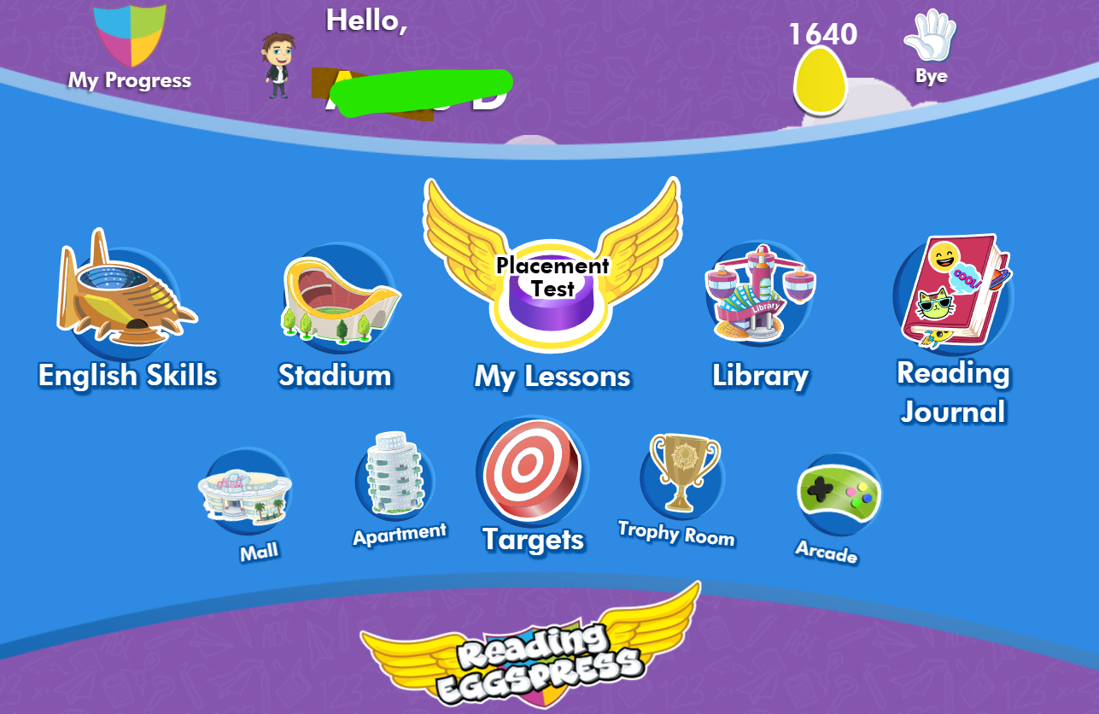
Homework
30 minutes per week
Learn new vocabulary
Comprehension skills
Exposure to writing styles

Slide 11
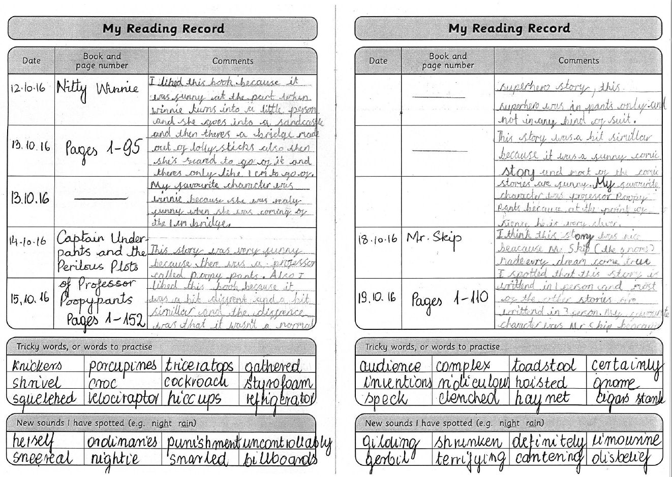
Reading Records examples
Reading books
Please remind your child to bring their reading book and record to school every day
Books will be changed every Monday and Friday
Once you have listened to your child read, please encourage them to write a comment in their reading record.

Slide 12

How can you help at home?
Support your child in managing their time so that they complete their daily home learning tasks.
To encourage independence, encourage your child to take responsibility around the home (e.g. chores – keeping their room tidy, etc)
Encourage children to listen carefully and remind them of the importance of following instructions.
45 minutes per day of reading, tables, spellings, etc
Keep off apps such as You Tube – highly addictive for children, distracts them.

Slide 13
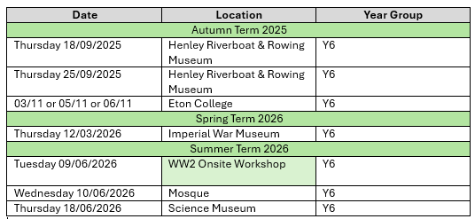
Key information you need to know
Year Group Trips

Slide 14
What do you do if you have a concern
Speak to your child’s class teacher at the end of the day.
Or email their class account:
maple@stmarys.slough.sch.uk
Speak to the Year Lead Ms Rockett
Speak to the Headteacher/Assistant Headteachers

