Slide 1


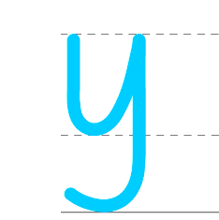
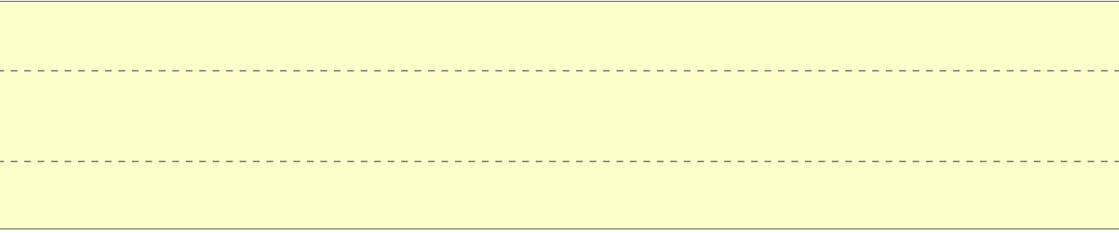
Monday 14th October 2024
Handwriting

Slide 2
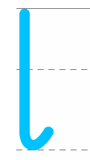


Tuesday 15th October 2024
Handwriting

Slide 3
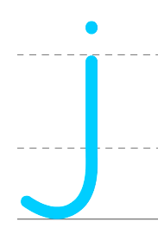
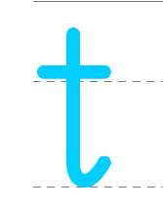
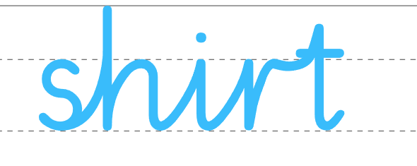
Wednesday 16th October 2024
Handwriting

Slide 4
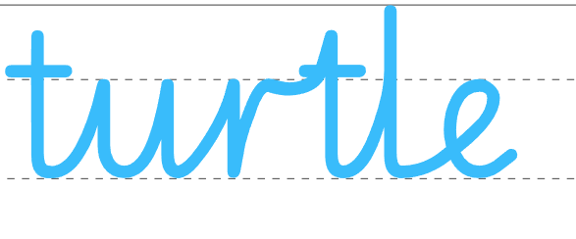
Thursday 17th October 2024
Handwriting

Slide 5
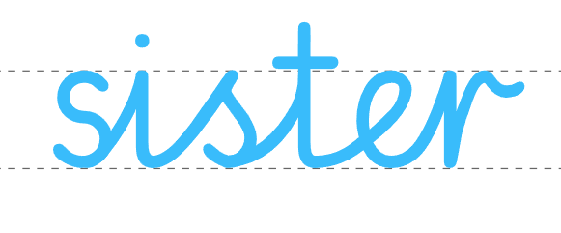
Friday 18th October 2024
Handwriting

