Slide 1
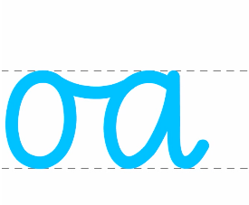
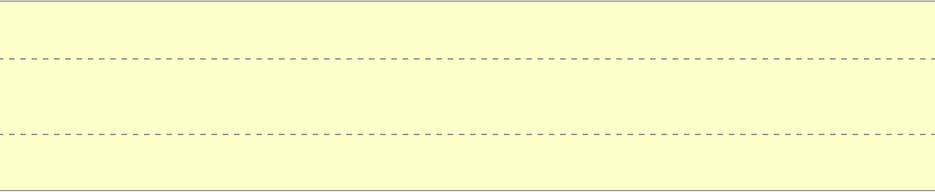
Monday 23rd September 2024
Handwriting

Slide 2




Tuesday 24th September 2024
Handwriting

Slide 3





Wednesday 25th September 2024
Handwriting

Slide 4
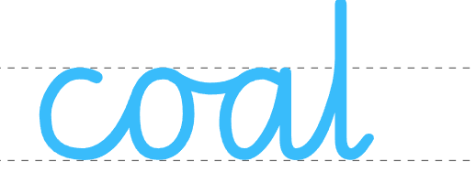





Thursday 26th September 2024
Handwriting

Slide 5
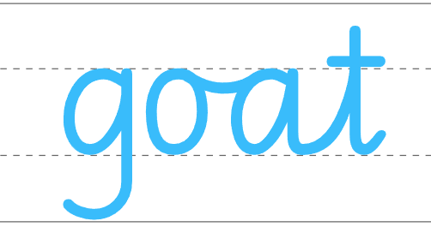

Friday 28th September 2024
Handwriting

