Slide 1
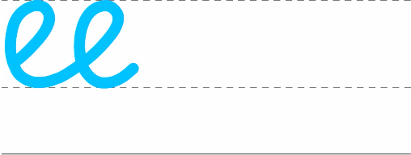
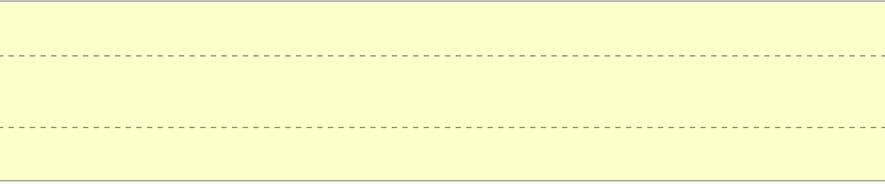
Monday 16th September 2024
Handwriting

Slide 2
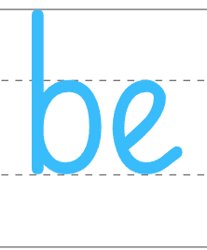
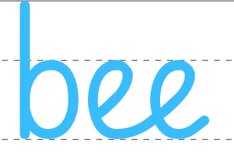
Tuesday 17th September 2024
Handwriting

Slide 3
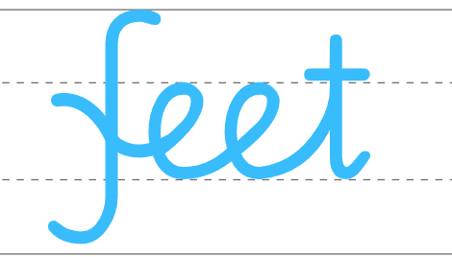
Wednesday 18th September 2024
Handwriting

Slide 4
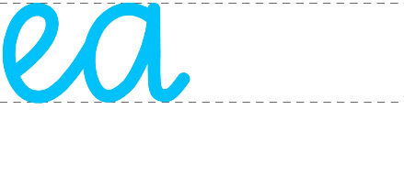
Thursday 19th September 2024
Handwriting

Slide 5
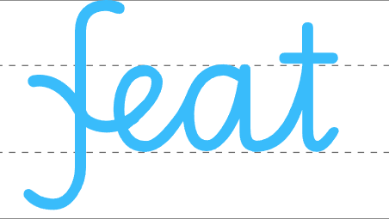
Friday 20th September 2024
Handwriting

