Slide 1
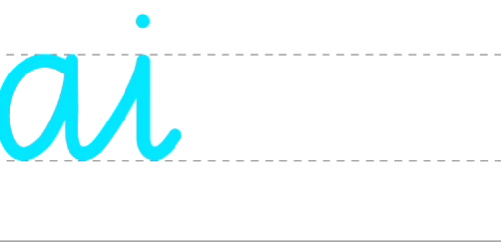
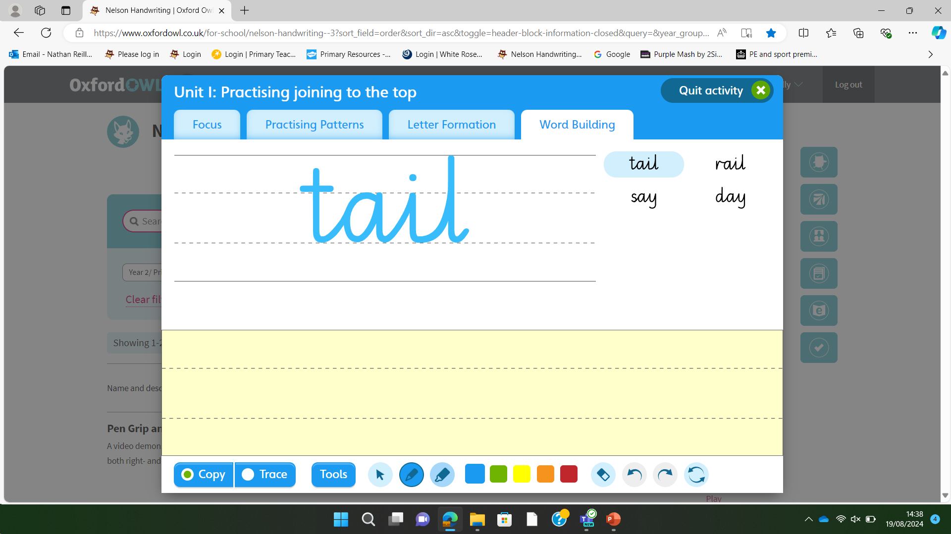
Monday 9th September 2024
Handwriting

Slide 2
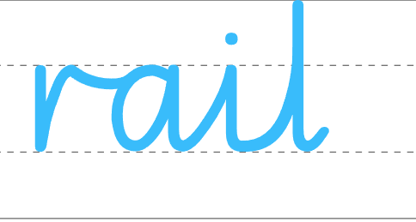
Tuesday 10th September 2024
Handwriting

Slide 3
Wednesday 11th September 2024
Handwriting

Slide 4
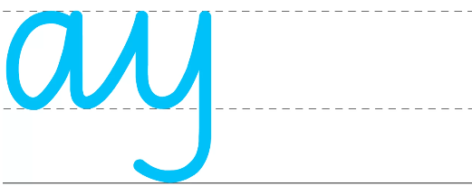
Thursday 12th September 2024
Handwriting

Slide 5

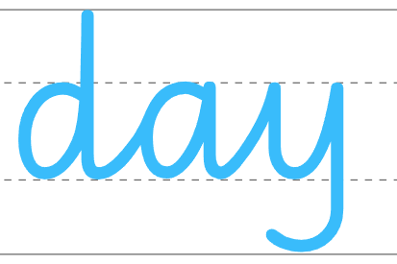
Friday 13th September 2024
Handwriting

