Slide 1

St Mary’s Church of England
Primary School
Meet the Year 1 Team
Autumn 2025

Slide 2
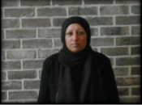
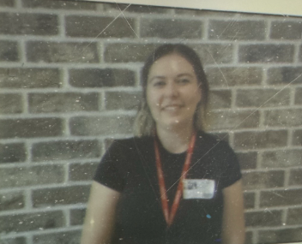
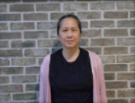
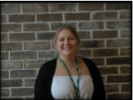
Meet the teacher
Year Lead – Miss Brindley– Cherry class
Mrs Akhtar (Monday)
Miss Jenkins
(Tuesday - Friday)
Damson Class
Mrs Crawford
Apple Class

Slide 3
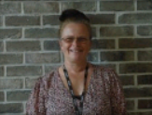

Adults working in Apple Class
Mrs Crawford
Apple Class Teacher
Ms Bradford
Support Staff
Ms Mattoo
Support Staff
Mrs Ghaffar
Support Staff

Slide 4


Adults working in
Cherry Class
Miss Brindley
Cherry Class Teacher
Year 1 Lead
Mrs Zeb
Support Staff
Miss Hughes
Support Staff

Slide 5
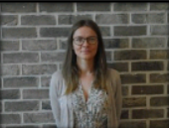
Adults working in Damson Class
Mrs Akhtar
Damson Class Teacher Monday
Miss Jenkins
Damson Class Teacher
Tuesday - Friday
Phonics Lead
Mrs Salgut
Support Staff
Miss Miller
Support Staff

Slide 6
Timetable
PE days – All children need to be able to get changed by themselves in school – please continue to practice and promote independence at home.
Apple P.E days: Tuesday and Wednesday
Cherry P.E days: Tuesday and Monday
Damson P.E days: Tuesday and Thursday.
All children should be in correct school uniform and correct P.E kits.
Children will come into school on their PE day wearing their full P.E Kit.

Slide 7
Key days:
Reading books will be changed on a Monday and a Thursday.
Phonics books will be sent home every 3 days. Please return them to school on a Friday.
Class library books will be changed every Friday.

Slide 8
Reading Records
You must sign the reading record and listen to your child’s reading every day!
Please write a short comment including things they may have struggled with.
If your child’s book IS NOT signed – the book DOES NOT get changed.
Books are changed every Monday and Thursday.

Slide 9
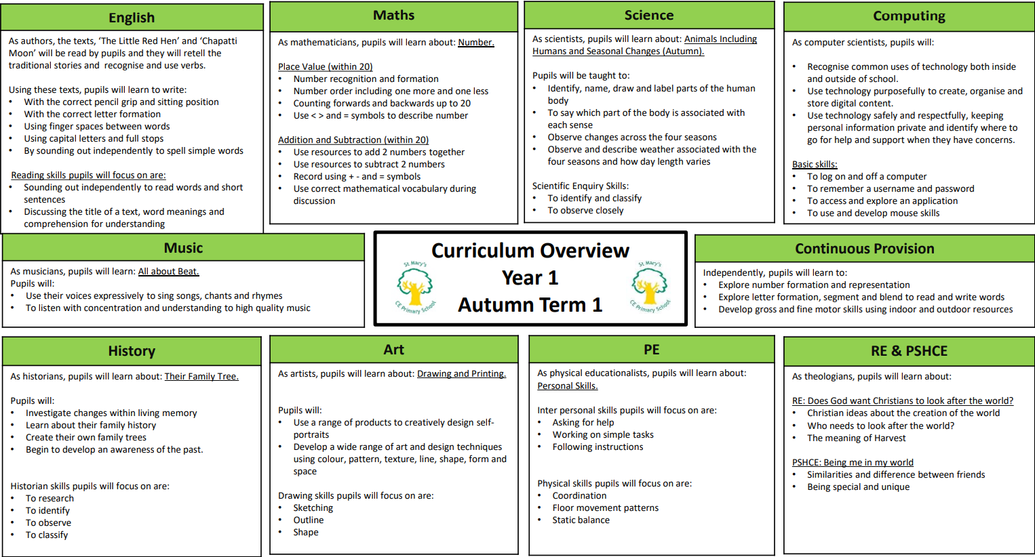
Year group curriculum

Slide 10
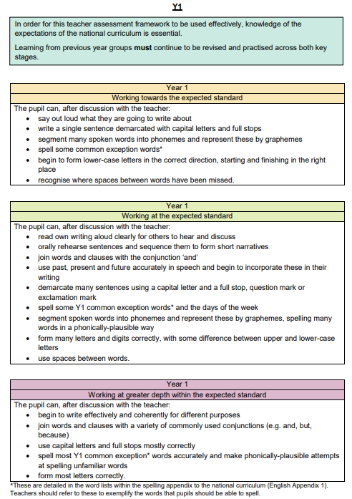
End of Year Expected Standards - English

Slide 11
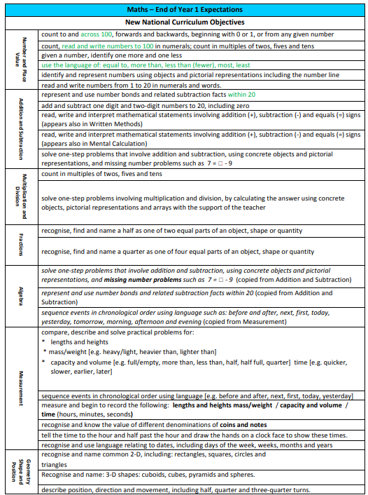
End of Year Expected Standards - Maths

Slide 12
How we will communicate with parents
Pupil, Parent, Teacher Consultations – October and April
Emails – please use class email accounts to contact class teachers
End of year reports - July
School website – this is regularly being updated and where the majority of homework will be shared. This is also where you will find information on the curriculum.
Newsletter
Text messages in an emergency/urgent
If your details have changed – please update via the office.

